Slide 1
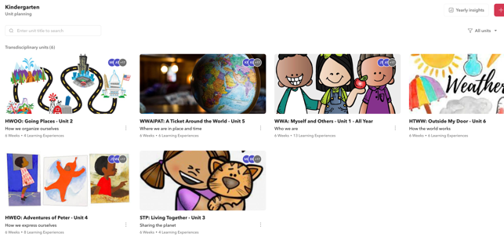
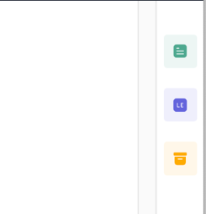
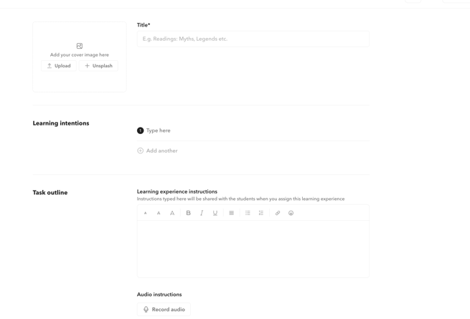
How to Reflect on units on Toddle
1. Go to the Prospect Website/click on teacher/staff and select Toddle. (Login with Microsoft) 2. Select the unit you would like to reflect on.
3. Click Reflecting tab - Read reflection prompts and complete reflection for teacher, student, assessment, and notes. Click ​Save and Exit
How to add a learning experience on Toddle (through website)
2. Select the unit you would like to add the learning experience to.
3. Click on the text below the unit. 4. Click on the blue tab (LE) at the side for learning experiences.
5. Press new- create new
Complete the information about the learning experience, add a title, upload an image, instruction, resources, templates, notes, learning goals.
Click save and exit on the top corner to add the experience when you are finished.

Slide 2
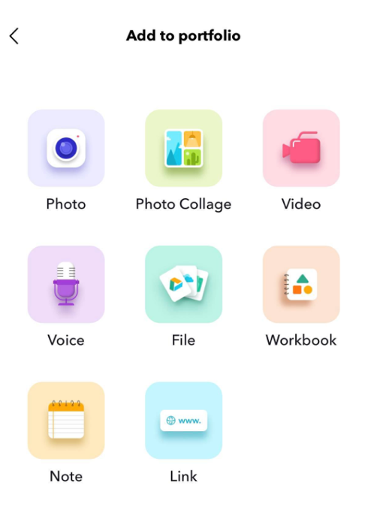
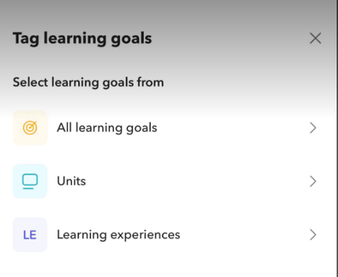
How to Add a Post on the Toddle Journal (Toddle App or website)
1. Open the Toddle App 2. Sign in with Microsoft
3.Click on the classroom tab and then journal
4. Press the red plus sign to add a post.
5. Select the type of post you would like to add- write a caption if necessary
6. Tag learning goals, select all learning goals, the unit and learning experiences that are related.
As of this time students do not have individual portfolios, just one class portfolio.

